Slide 1
ONLINE PROPERTY MANAGEMENT

Slide 2
ABSTRACT
The main objective of this project is to bring the real estate industry online and enabling real estate industry participants to benefit from the Internet. Site acts as an interface between Individuals, brokers and realtors. Here the user can advertise his property for buying or for selling.
Site provides online real estate and related services to customers to make eye catching and full profit decisions related to buying, selling, renting and leasing of properties, in India. We will provide a fresh new approach to our esteemed users to search for properties to buy or rent, and list their properties for selling or leasing. Property promises to be the most preferred way of finding your dream property and we are committed to help you make a wiser property decision, as a buyer or a seller.

Slide 3
HARDWARE SPECFICATION
Processor : P 4 700 GHz.
RAM : 4 GB RAM
Hard Disk Drive : 180 GB

Slide 4
SOFTWARE SPECIFICATION
Operating System : Windows 7/8/10
Front End : JAVA
Back End : SQL

Slide 5
EXISTING SYSTEM
If customer is interested in buying that flats, Developer sales the property/flat by completing all formalities, and makes entry into the Customer Details Register manually. All the permanent data of the order such as the name of the property/flat, Estate_ID, as well as name of buyer/customer, Member_ID and so on are maintained in a master file for future reference. The customer has the option of paying by cash or check or credit card. At the time customer pays the price he is issued a receipt acknowledging the same
Disadvantages:
All the above-mentioned tasks are taken care off manually
The details of all the Properties, customers, stocks and feedbacks are maintained in separate registers

Slide 6
PROPOSED SYSTEM
The user can have fast interaction with the system by inserting keywords at the respective places, by clicking on the buttons or links etc. Because not only the front end provides the faster interaction with the records but with back end also provides the proper interaction with the records and gives or prompts the information to the end user if he is making error during work.
Advantages
Searching feature is quite faster than current system. Because it searches directly from system that is from the front end.
The most important feature of this system is online exhibiting the properties, This saves time to visit at the actual place where the property is located

Slide 7
Modules
Admin Profile:
Admin profile is profiled which is assigned to a superuser having full access to the system. Admin module contains Admin Id, name, address, contact no. Admin can view the property details make changes if required, delete the property details. Check the payment status, view, and manage the client details. Any issue in the client’s details or in property details just reports to the admin.
Client Profile:
The client profile is for those who want to buy, sell, or rent the property for their uses. Client profile contains Client id, name, address, contact details, etc. Clients can view the property. If it is available and the client is willing to buy or rent. They can pay online or offline.

Slide 8
Property Details:
Property details hold the data about the property in property location, total value, owner, etc. The property gives an idea about the property which helps the clients to choose the property.
Search Property:
There is a lot of property. Clients may be confused to search their desired property. Clients can search property using property types like residence, offices, faculty, and etc. Property can be searched by property status. Property can also be searched using property value and much more. If there is some legal problem with the property. Then it would be unavailable to rent or buy.
Booking:
Once the property is searched and the client finds the desired property. This module helps the client to book the property. This module collects the information and checks the information from the backend. If data is verified then the client redirects to the payment page.

Slide 9

Data Flow Diagram
Level 0:

Slide 10
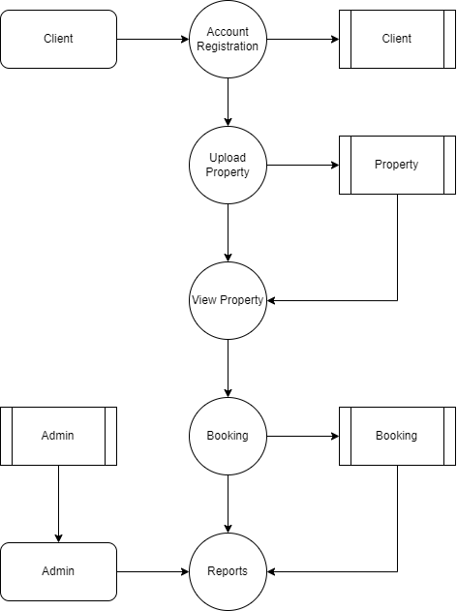
Level 1:

Slide 11
TABLE DESIGN TABLE NAME:ADMIN
FIELD | DATA TYPE | SIZE | CONSTRAINT
Admin id | Int | 10 | Primary key
Username | Varchar | 30 | Not null
password | Varchar | 30 | Not null

Slide 12
TABLE NAME:Property
FIELD | DATA TYPE | SIZE | CONSTRAINT
Property id | Int | 10 | Primary key
Title | Varchar | 20 | Not null
Details | Varchar | 50 | Not null
Delivery Type | Varchar | 10 | Not null
Price | Int | 10 | Not null
Address | Varchar | 50 | Not null
Bed room | Int | 2 | Not null
Liv Room | Int | 2 | Not null
Parking | Int | 2 | Not null
Kitchen | Int | 2 | Not null
Type | Varchar | 10 | Not null
Space | Varchar | 10 | Not null
Agent Id | Int | 6 | Freign Key

Slide 13
TABLE NAME:Agent
FIELD | DATA TYPE | SIZE | CONSTRAINT
Agent id | Int | 10 | Primary key
Name | Varchar | 20 | Not null
Address | Varchar | 50 | Not null
Contact | Int | 10 | Not null
Email | Varchar | 20 | Not null

Slide 14
TABLE NAME:Image
FIELD | DATA TYPE | SIZE | CONSTRAINT
imageid | Int | 10 | Primary key
Property Id | Int | 10 | Foreign Key
Image | Varchar | 30 | Not null

Slide 15
Thank You

